Slide 1
FastFasion
Case Study

Slide 2
Problem Statement 1
Aggregate the Quantity for each Store-Style level at a week level (week starts from Monday) and identify the top products being sold at each of the stores. Highlight if there is any change in product preference in 2019 as compared to 2018.
The questions can be broken down into 3 parts :
Aggregate the quantity sold or each Store-Style level at a week level
Week starts from Monday
Quantity sold -> transactions
Identify the top products being sold at each of the stores.
Highlight if there is any change in product preference in 2019 as compared to 2018.

Slide 3
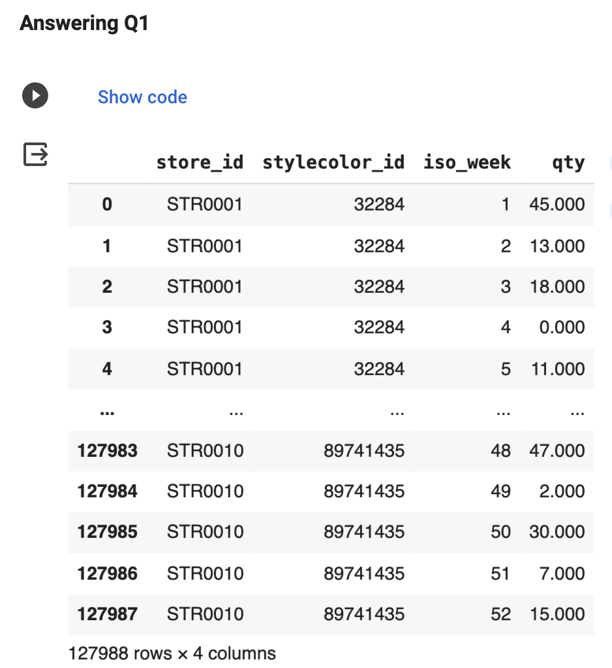
Solution 1
STEPS For Part 1 :
Find the iso_week of the transactions from the transactions table
Merge the transaction data with the master product data
Group by store_id, iso_week, and stylecode_id to get the Store-Style level at week level data
The Result can be seen in Figure 1.1
Figure 1.1 :
Table of Store-Style level at week level

Slide 4
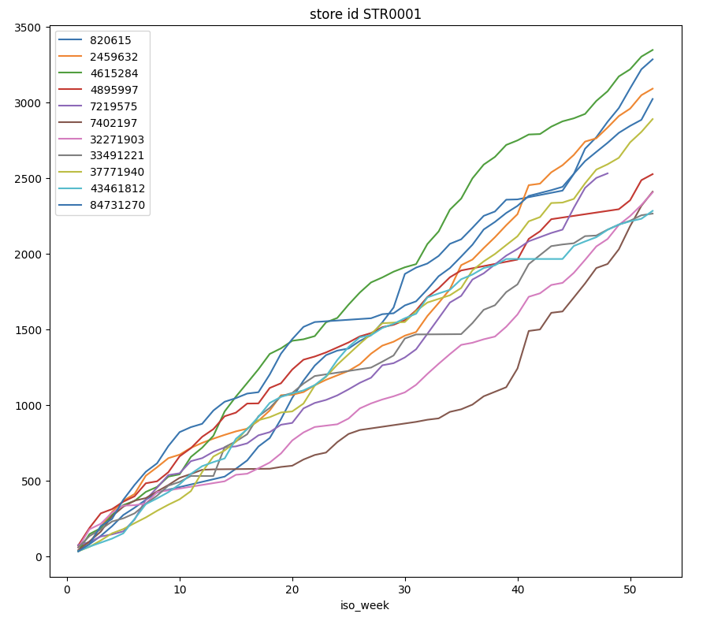
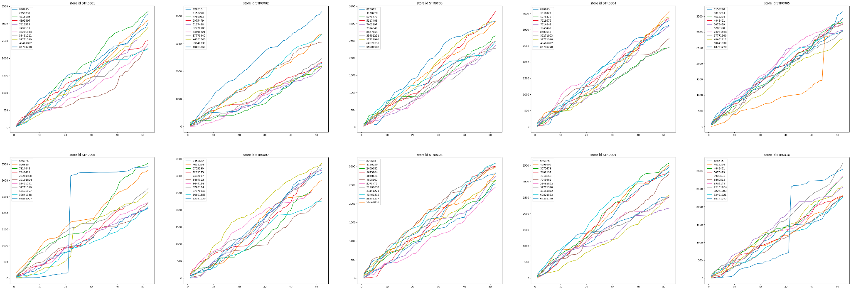
Solution 1
These are 11 styles that were top sellers across all the stores : 820615, 4615284, 4848421, 5075479, 7949461, 8407512, 8785174, 29101804, 32271903, 33491221, 65121222
There is huge variation is total sales between the best of the top sellers in a store, verses the worst of the top sellers
Figure 1.3 : Plot of cumulative weekly sales for top selling styles

Slide 5
Solution 1
STEPS For Part 3 :
Data for 2018 was missing in the transaction table, while the data for 2019 was made available. Thus, a comparison study could not be made between the sales data for 2018 and 2019
Provided the data the similar approach can be taken to compare the top styles being sold between the two years

Slide 6
Problem Statement 2
Detect the Outliers in the Quantity for each Store-Product combination and apply an outlier treatment on the same. Specify the outlier treatment technique
STEPS for Solution :
Detect outliers in residuals, post trend, seasonal decomposition
Test Different approaches
IQR
Z-score
Exponential Moving Average

Slide 7
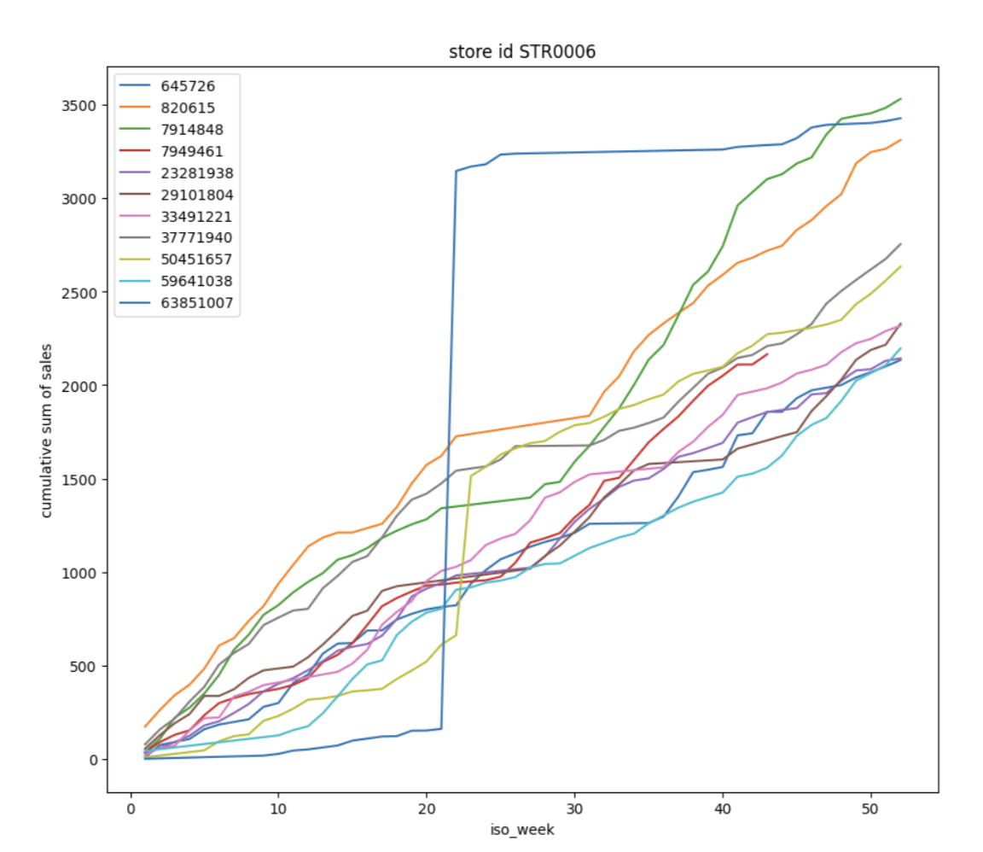
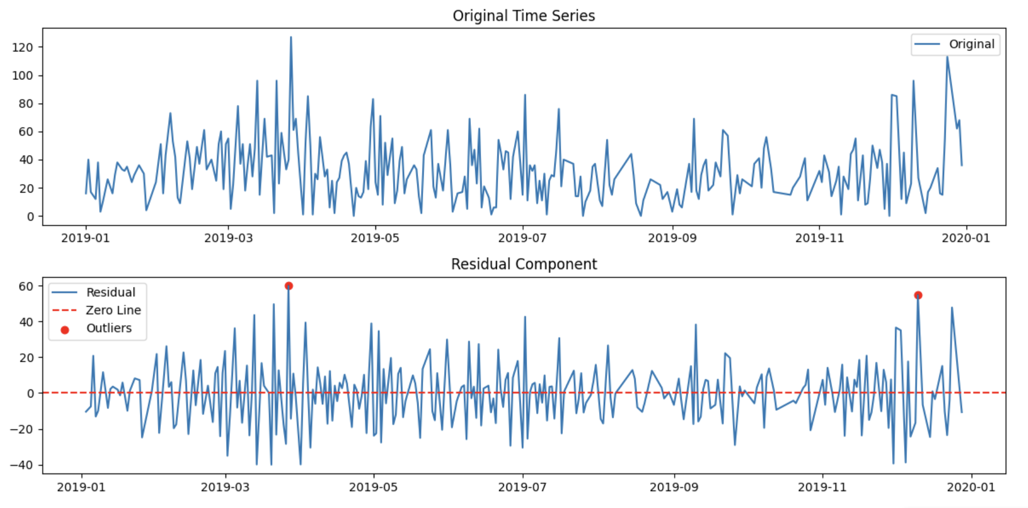
Solution 2
Point Outliers / Spike Outliers :
Based on visualization we can observe that the outlier types are spikes (Figure 2.1)
Outlier can be seen in residual plots - made post decomposition (Figure 2.2) - challenge being estimating seasonality time period. Thus ema was used (shown below).
Figure 2.1 : Residual plot with outliers being marked
Figure 2.2 : Spike Outliers in Sales data

Slide 8
Solution 2
Outlier removal can be done using the 3 approaches mentioned below. The table also shows a comparison of each of the methods:
Approach | Pros | Cons
IQR (Interquartile Range) | - Robust to outliers - Simple to compute | - Data-driven imputation - May introduce bias
Z-Score (Standard Score) | - Utilizes standardization - Detects and handles outliers | - Data-driven imputation - Loss of information
EMA (Exponential Moving Average) | - Temporal awareness - Smoothing effect | - Sensitive to parameter selection - Does not handle outliers - Doesn't provide statistical boundaries
Use IQR when robustness to outliers is crucial, and you are not concerned with capturing temporal patterns
Use Z-score when you want to standardize the data and handle outliers effectively, but are not focused on temporal aspects
Use EMA when you want to impute missing values while considering the time series' temporal structure, especially for capturing trends and seasonality. However, be cautious with parameter selection and outliers
Ref : https://s-ai-f.github.io/Time-Series/outlier-detection-in-time-series.html#introduction-1

Slide 9
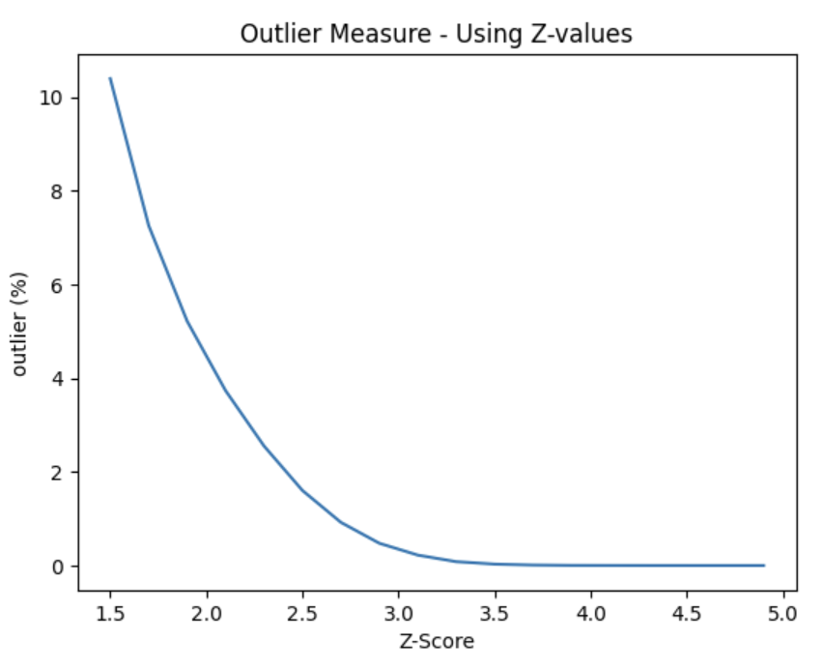
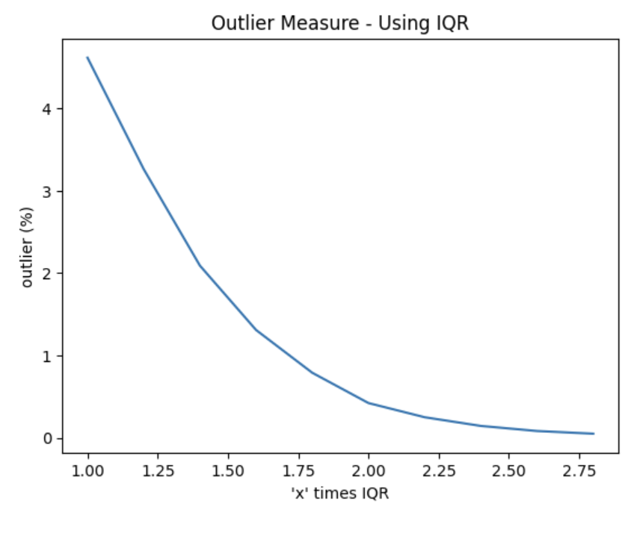
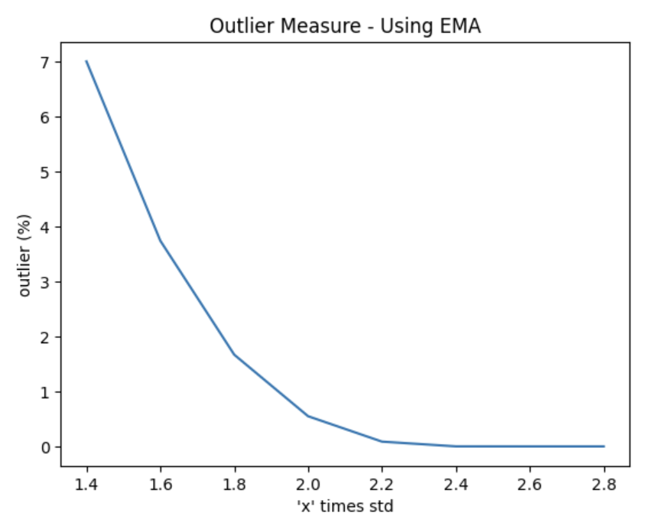
Solution 2
All three outlier removal methods are compared for the % of transactions that result to being tagged as outlier :
Figure 2.3 : Plot of cumulative weekly sales for top seller products
We choose Exponential Moving Average approach as it incorporates trend and is time aware, which makes it a more robust technique than Z-score or IQR.
If the residual of a point was 1.8 times the standard deviation of all residuals, it was considered an outlier. Using this technique only 1.8% of the transactions were recorded as outliers.Such data points were removed from the data set.

Slide 10
Problem Statement 3
Check the data for missing values at Store-Product Level and apply the missing value treatment by imputing the missing values by either mean or median or any other value. Also provide the reasoning for the missing value treatment method used
The questions can be broken down into 3 parts :
Check the data for missing values at Store-Product Level and
Apply the missing value treatment by imputing the missing values
Provide the reasoning for the missing value treatment method used

Slide 11
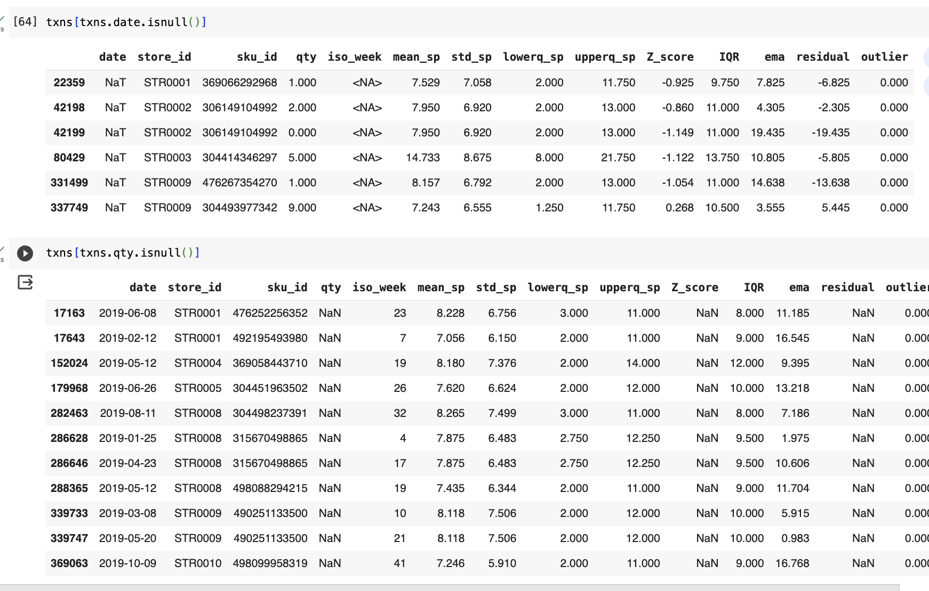
Solution 3
There were two columns with null values observed :
Date Column - For the date columns, an algorithm was developed to detect the missing date from the sales data. and corresponding date was selected. This algorithm can be improved
Quantity Column - For missing quantity, the EMA was used impute the sale quantity. EMA was used because it captures trend as well as time series component.

Slide 12
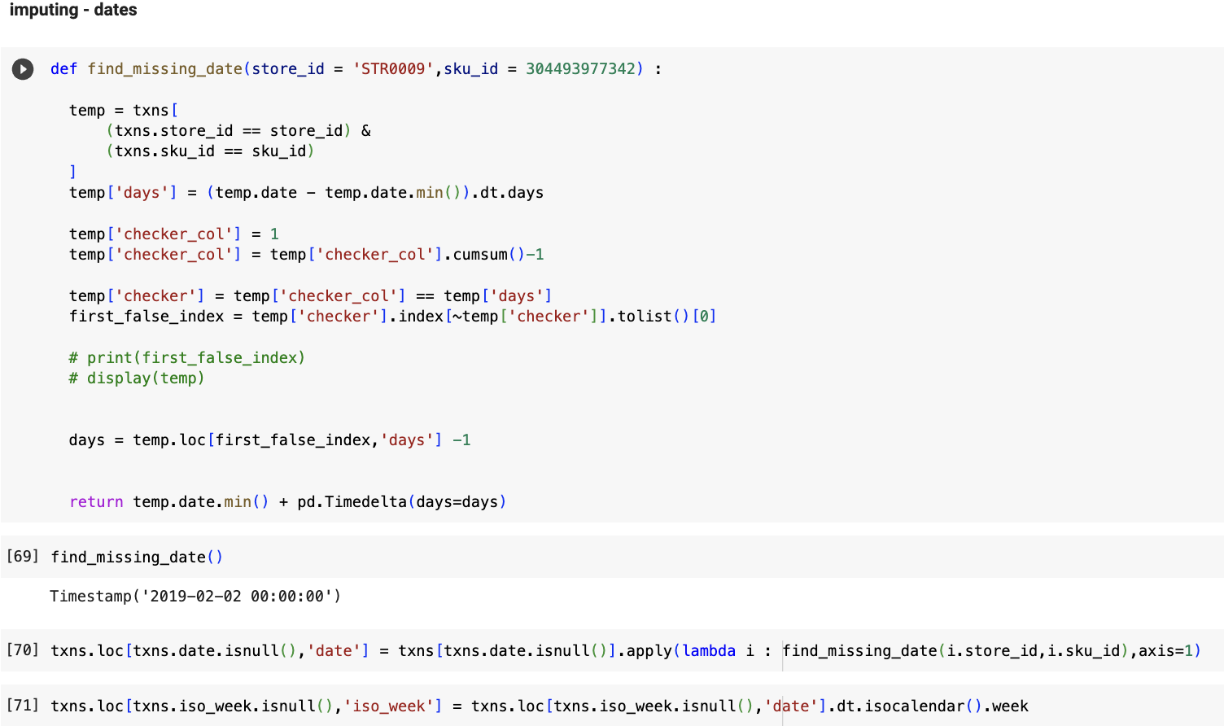
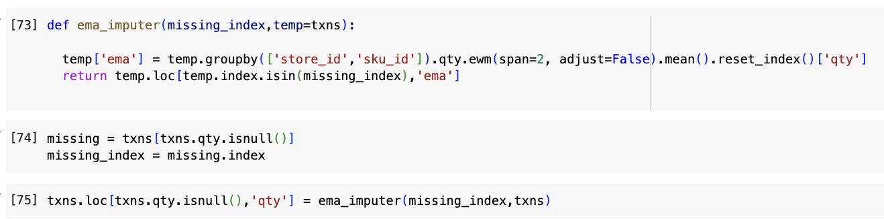
Solution 3
Date Column - For the date columns, an algorithm was developed to detect the missing date from the sales data and corresponding date was selected. The algorithm can be seen in Figure on the left. Why? - Later Investigation revealed that the sales is not continuous. And thus this algorithm was not appropriate. But since the missing count was low, and for the interest of time, this wasn’t prioritized
Quantity Column - For missing quantity, the EMA was used to impute the sale quantity. It can be seen on the right. Why? - It captures trend of the time series component.

Slide 13
Problem Statement 4
Split the future forecast given at Style-Week level into Store-SKU-Week level using appropriate logic. Please specify the logic and rationale behind the decision. Also, highlight the approach to handle new products.
The questions can be broken down into 3 parts :
Split the future forecast given at Style-Week level into Store-SKU-Week level using appropriate logic
Please specify the logic and rationale behind the decision
Highlight the approach to handle new products

Slide 14
Solution 4
Solution Flow diagram
Style level forecast
SKU level forecast
SKU-store level forecast
Clustering is used to group styles that have similar size ratio.
This clustering can future be augmented with, data like material, color, and other characteristics to predict the the split across new products.
Clustering is used to group styles that have similar store-distribution ratio.
This clustering can future be augmented with, data like material, color, and other characteristics to predict the the split across new products.

Slide 15
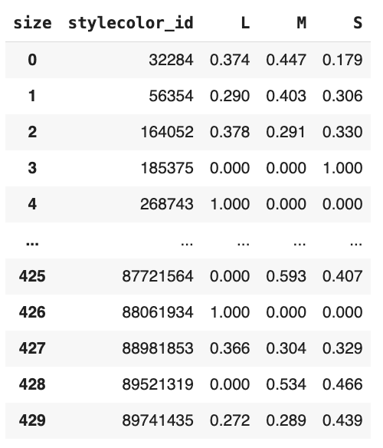
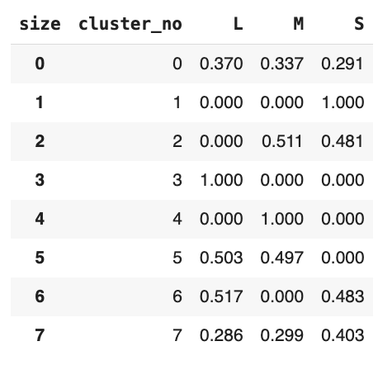
Solution 4
Explored how to break down from styles to SKU. It was observed that for each Style there were different sizes, which map to different SKU
Therefore we had to map each style into the different sizes. Since, Historical transaction can be mapped into the forecast, we explored the transaction data. Using the ratio of transactions done across different sizes of each style, we created a map. This can be seen in Figure 4.1. For each of the 430 styles there were different ratios.
These styles were then grouped into 8 groups. Using clustering. Each group having unique ratios of sizes. This can be observed in the Figure 4.2. The grouping was done using K-means clustering.
Figure 4.1 :
Style to Size-Ratio
Figure 4.2 :
Style-Cluster to Size-Ratio

Slide 16
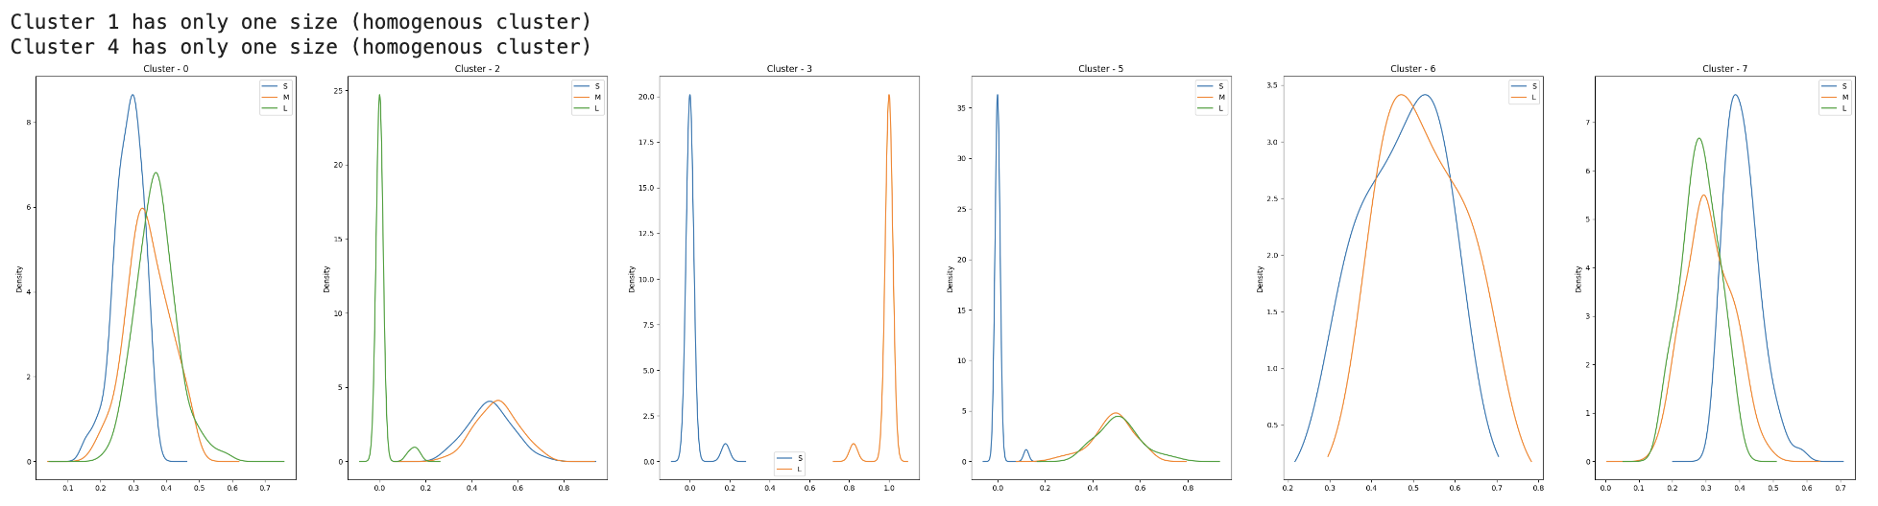
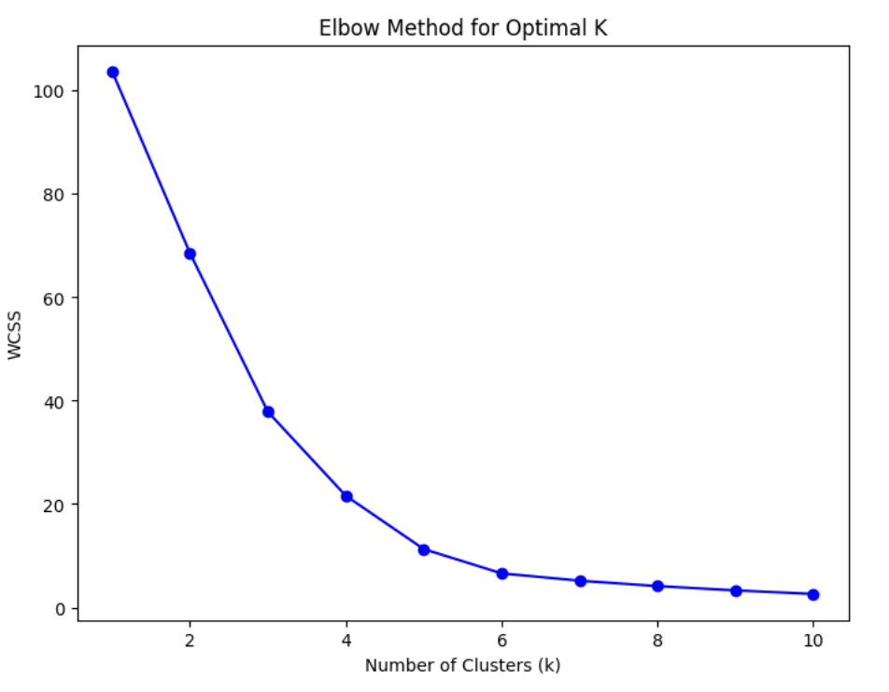
Solution 4
We can observe that each cluster size distribution is unimodal. Making the clustering impactful, and distinctive from each other. This grouping was effective (Figure 4.3)
In Figure 4.4 you can observe the elbow plot of the clusters
Figure 4.4 : Clustering Elbow Plot
Figure 4.3 : Style-Cluster to Size-Ratio

Slide 17
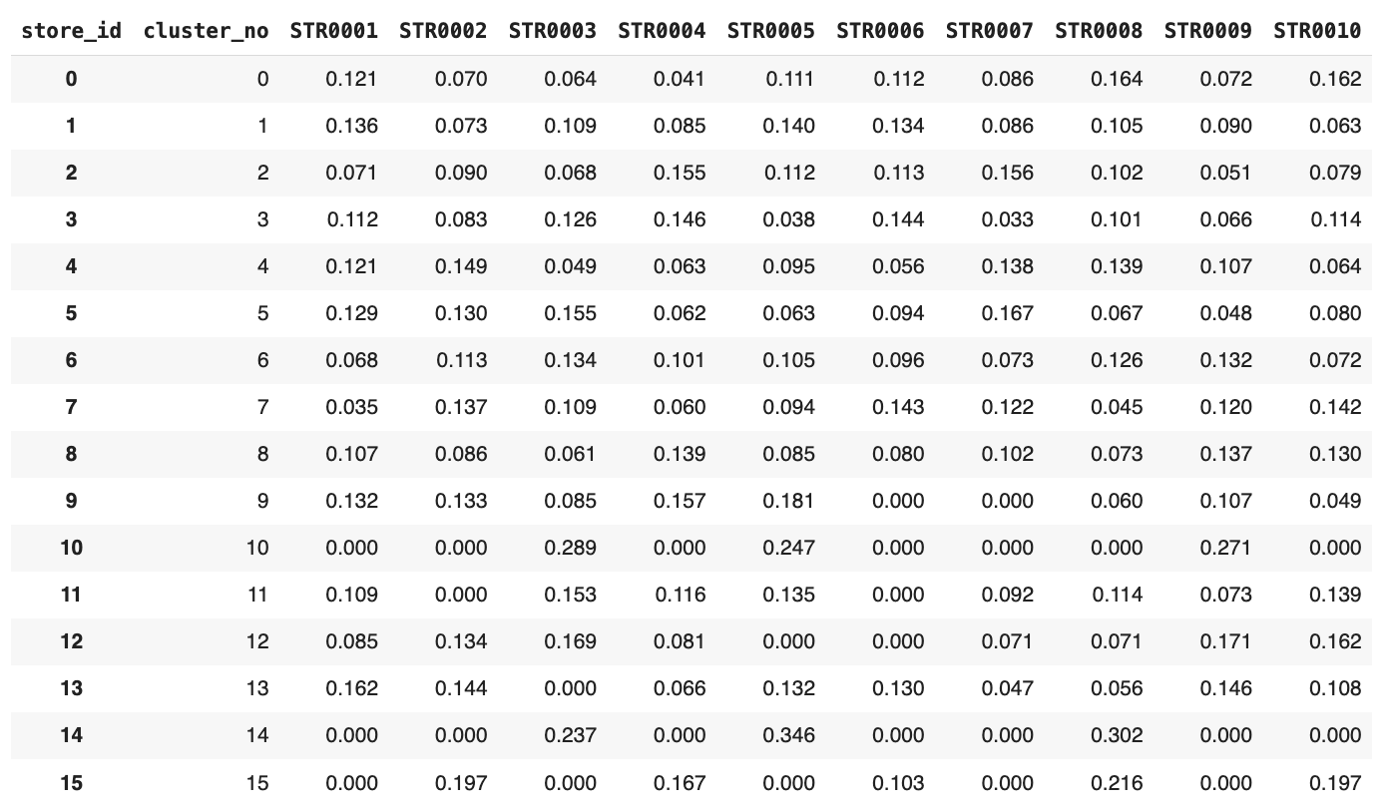
Solution 4
Figure 4.5 : Style-Cluster to Store Rato
We had to find a mapping for each style into different stores. Since transaction data can be used to split the forecast. we explored the store distribution in the transaction data. Using the ratio of transactions done across different stores of each style, we created a map.
These styles were then grouped into 16 groups. Each group having unique ratios store distribution. This can be observed in the Figure 4.5. The grouping was done using K-means clustering.
This grouping was effective as it can be observed that each of the cluster has unimodal distribution Figure 4.5

Slide 18
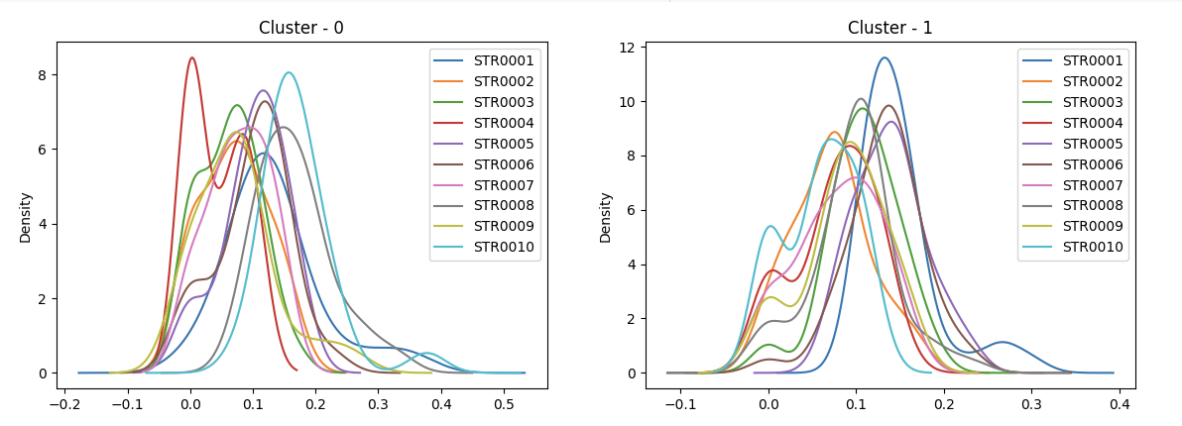
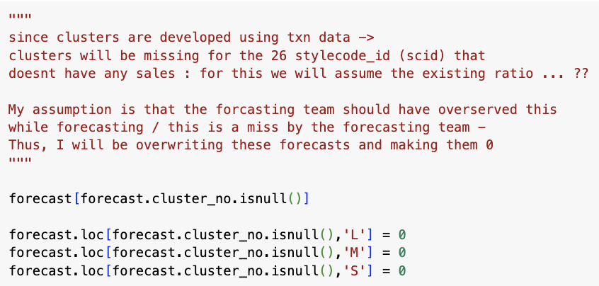
Solution 4
We can observe that each cluster size distribution is mostly unimodal. Making the clustering impactful, and distinctive from each other. This grouping was effective (Figure 4.6)
How was new product handled* :
There were 26 style codes that were missing in the transaction data in 2019. The assumption is that these are forecasted sales based on multiple years of data. While there have been no sales for these styles in the last year. Thus, this was a mistake by the forecasting team and these were forecasted to 0.
Figure 4.5 : Distribution before clustering
*While creating the notebook the following approach to handle the missing styles in transaction data was considered. Later while re-looking at the questions it was proposed to look at these style codes as new products. Can explore ideas during discussion call
Figure 4.6 : Distribution before clustering

Slide 19
Problem Statement 5
Given the latest inventory position of stores (as per “Store_inventory” file), generate next 4 allocation plans (one for each of the first 4 weeks of 2020). In scenarios with limited inventory (less than store level demand), the priority should be given to the store having higher sales potential.
The questions can be broken down into 2 parts :
Given the latest inventory position of stores (as per “Store_inventory” file), generate next 4 allocation plans
In scenarios with limited inventory (less than store level demand)
The priority should be given to the store having higher sales potential.
Other constraints :
FastFashion wants to maintain a stock to satisfy the next 4 weeks of demand for each SKU and each store at any point in time

Slide 20
Solution 5
Solution Flow diagram
Forecast of
SKU at store
For Weekly stock demand at store
Demand plan
of SKU at store
Algo
Algo
4 week roll up
Next week stock –
This week stock
Algo
1. For each sku, divide by the stock count in packet to determine packet requirement
2. For each pack required by store to fulfill SKU requirement, select the max quantity of that packet
Algo
On the Demand plan of Pack at Store :
Iterate over each DCs
Allocate to the highest selling store first
forecast based
If stock remaining & constraint checks are cleared - allocate to other stores
The steps 1 to 3 are repeated for all weeks
Allocation plan
Demand plan
of Pack at store

Slide 21
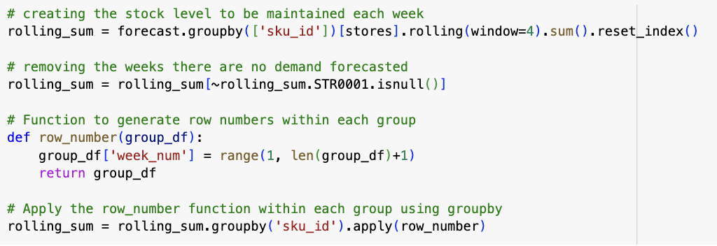
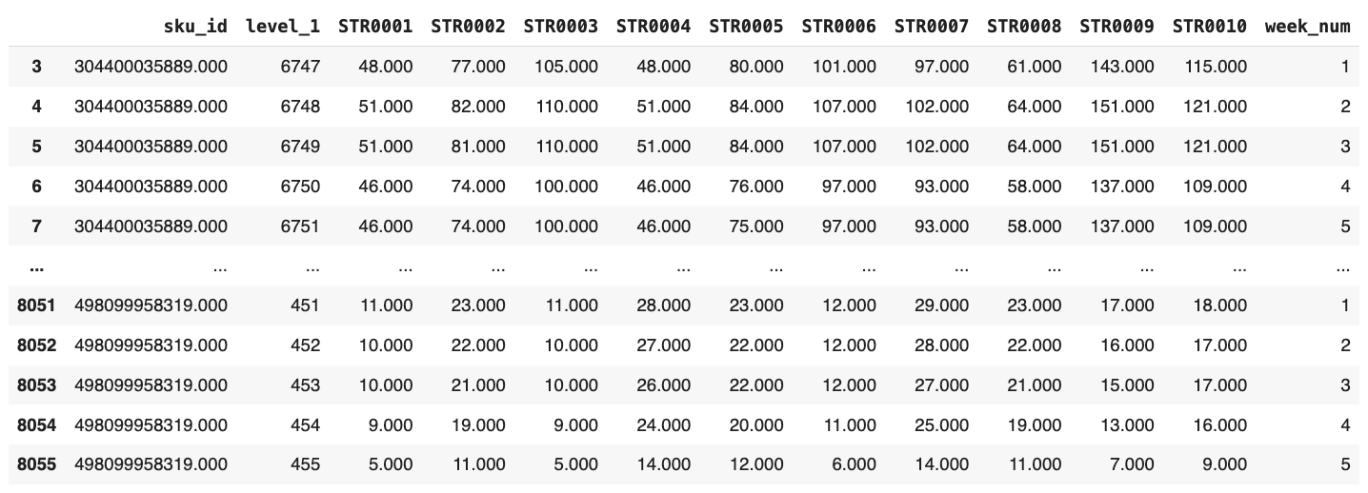
Solution 5
For “Weekly stock demand at store” : First we create a rolling stock level at a 4 week basis. This is the level of stock that needs to be maintained in the beginning of the week. The Figures 5.1 show the code and the stock level requirement :
Figure 5.1 : Generation Code & “Weekly stock demand at store”

Slide 22
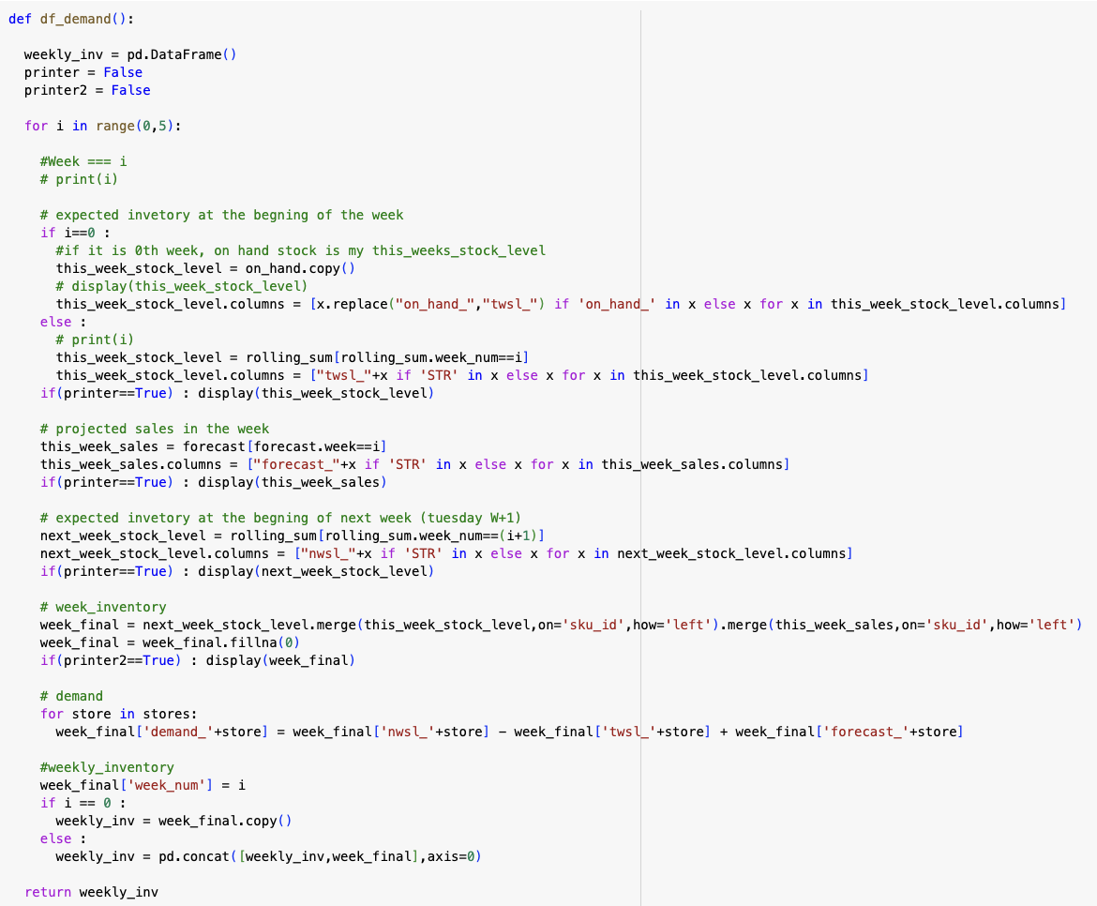
Solution 5
Figure 5.2 : Code for generating Demand plan of SKU at store
My assumption is that this week's W0 is before W1 of 2020
Stock for January (4 week rolling demand) forecast is shipped before W1 begins - because this is done the min stock is maintained by default, and ignored during allocation plan
I am assuming the code is run/reviewed on Fridays (just for nomenclature purposes) - next_week / this_week
On order stock were ignored for this calculation. They can be directed added post the allocation plan
The function in Figure 5.2 was used to generate “Demand plan of SKU at store” (from flow diagram)

Slide 23
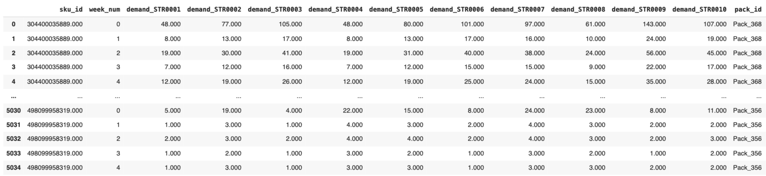
Solution 5
Demand plan of SKU at store = Next week level – This week stock level The plans is shared in (Figure 5.3)
Figure 5.3 : Demand plan of SKU at store

Slide 24
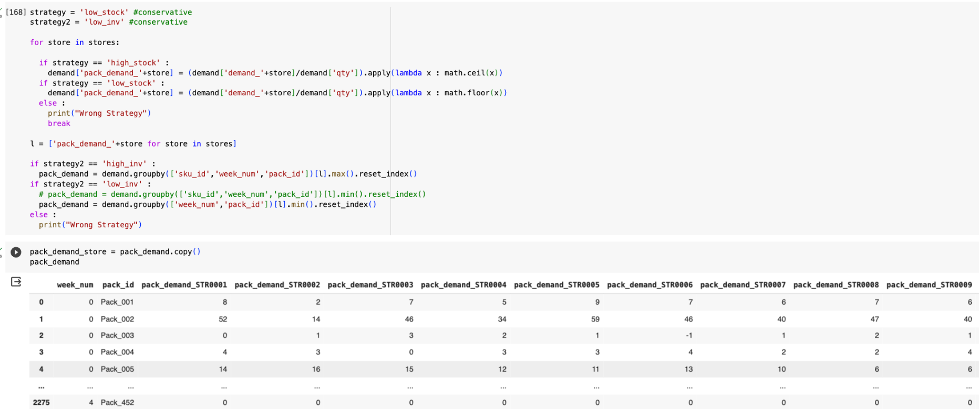
Solution 5
“Demand plan of Pack at store” from flow diagram (Figure 5.3) :
Figure 5.4 : Generation Code & Demand plan of Pack at store

Slide 25
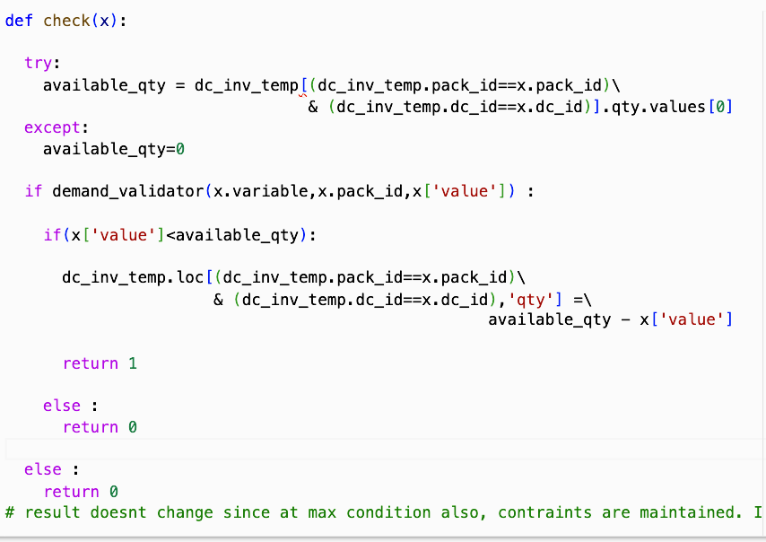
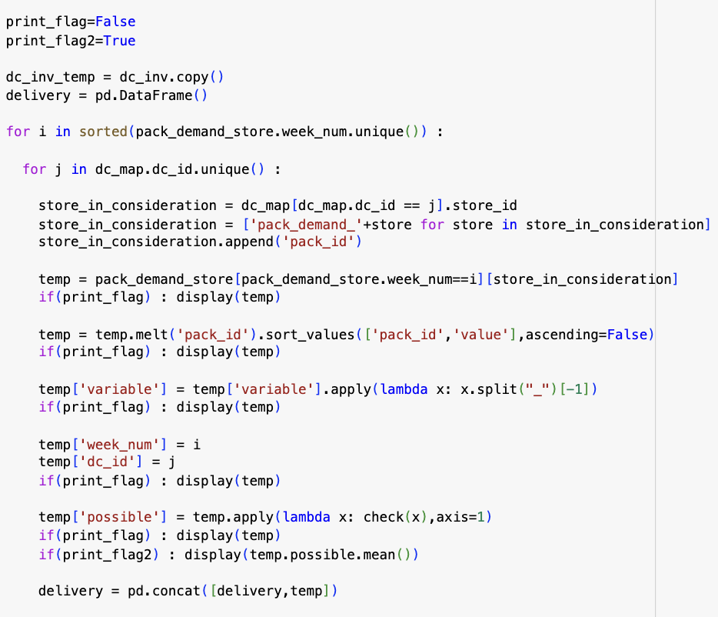
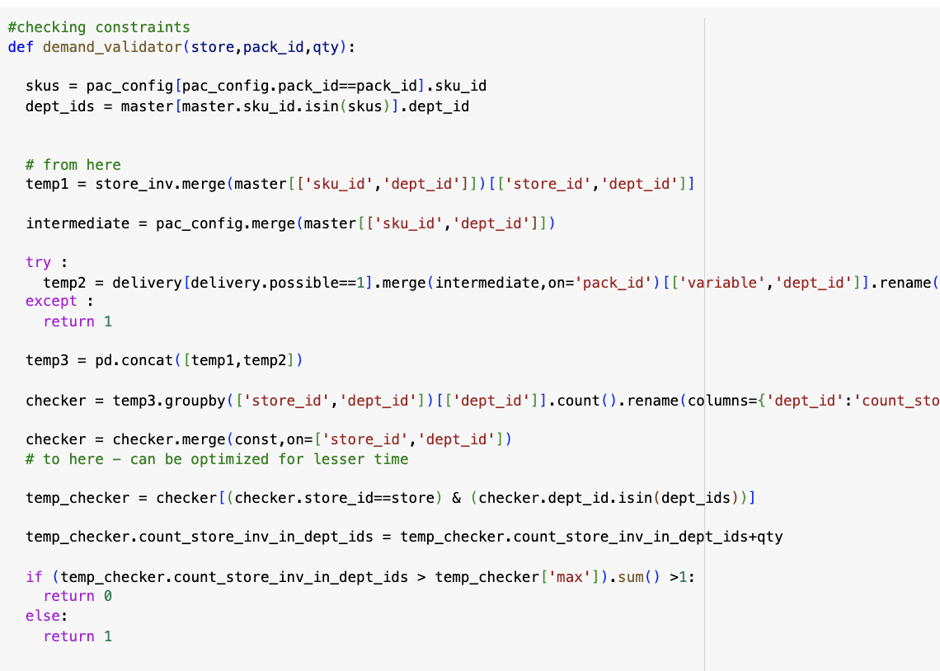
Solution 5
The Allocation plan required 3 functions :
Allocation Algorithm : This function Prioritized the store with higher demand. The algo addresses the highest sale potential store first as per the problem statement. (Figure 5.5.1)
Check Function : This function checked whether there is available stock in the DC. (Figure 5.5.2)
Constraint function : This function validated constraints. (Figure 5.5.3)
Figure 5.5.2 : DC Inventory Check Algorithm
Figure 5.5.3 : Constraint Check Code
Figure 5.5.1 : Allocation Algorithm

Slide 26
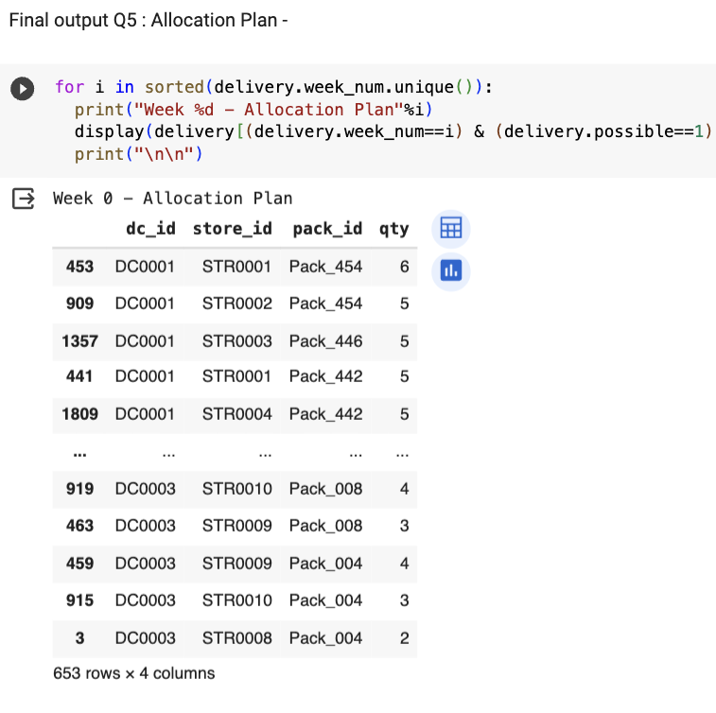
Solution 5
Weekly Allocation plan is displayed
Figure 5.6 : W0 - Allocation Plan

Slide 27
Problem Statement 6
Compare the allocation plans with the demand estimate at Store-Week level. Define and calculate a stockout metric to measure effectiveness of each of the allocation plans.
The questions can be broken down into 2 parts :
Create a dataframe that can be used for comparison
Create a composite metric

Slide 28
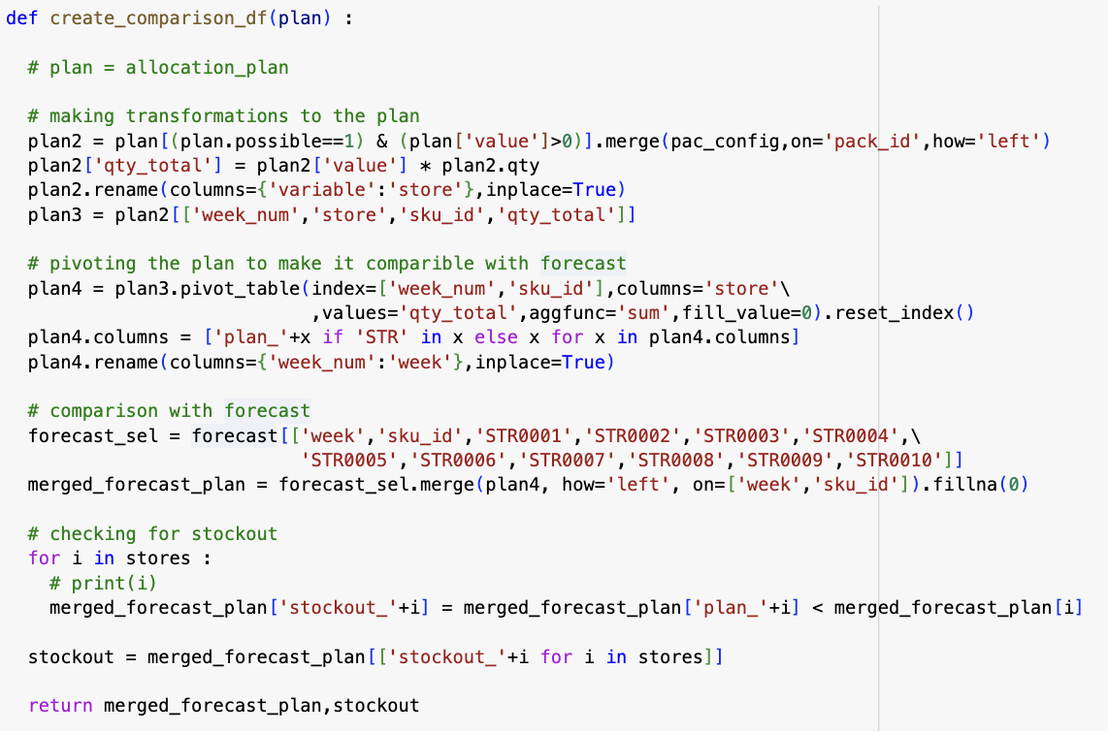

Solution 6
Compare allocation plans with with forecasting or with the rolling demand created? - I am choosing to do it at forecasting level
An algorithm to compare allocation with forecast was made
The Stockout Metric measures - how many times were the demand not met. Every week the demand is not it is counted as a stockout. Same product across different stores are considered as stockout. (Figure 6.2) There was consideration for stockout to be calculated at DC level, but business context was required to take this decision
This metric can be checked at a store level, or week level granularity.
Figure 6.1 : Generation Code for Comparison DataFrame and Stockout Table
Figure 6.2 : Stockout Metric

Slide 29
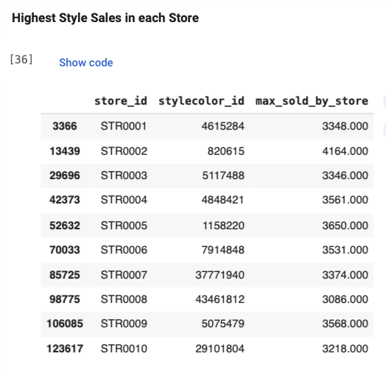
Solution 1
STEPS For Part 2 :
Performed data wrangling to find each stores’ highest selling stylecolor_id. (Figure 1.2)
Based on Figure 1.2, we can see that the styles that are the highest selling styles in each store is different
Finding the highest selling style is not actionable for the business team. Thus along with the highest selling styles, a plot to show the top selling styles, styles that are in the top 2% percentiles in terms of quantity sold in each store.(Figure 1.3) Insights from Figure 1.3 and the figures shared in the next page
Figure 1.2 :
Table of Highest Selling Style at each Store

